Slide 1
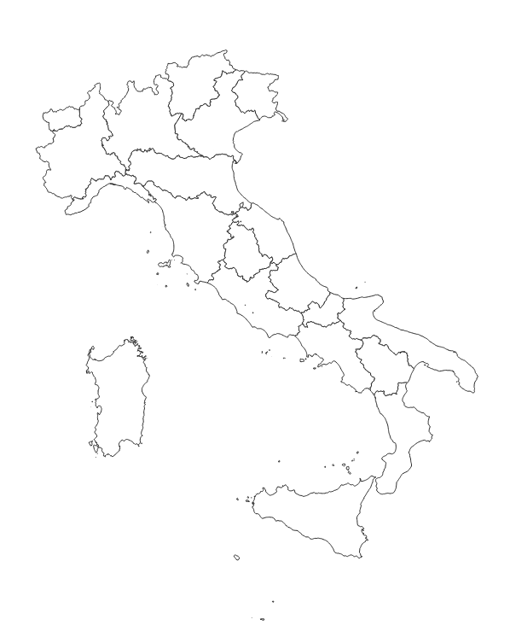
LANDSLIDE HAZARD AND RISK MAP PROJECT
AUTHORS
Giovanni Montefoschi
Zhanbin Wu
Xiao Tan
INSTRUCTOR
Giovanni Quattrocchi
TA:Vasil Yordanov
Group name:Hazard_Maps_Project-SE4GEO

Slide 2
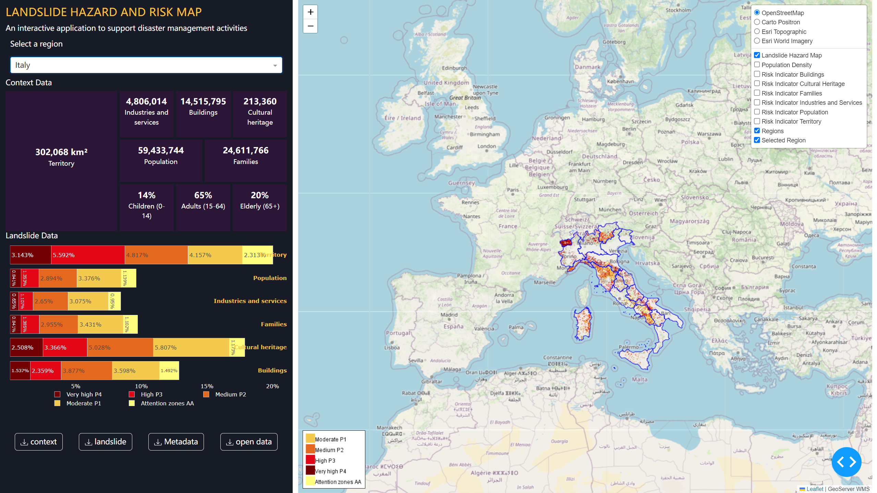
dashboard

Slide 3
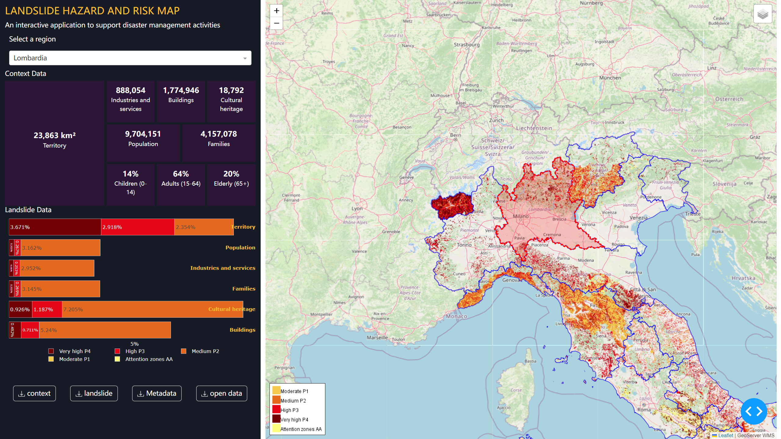
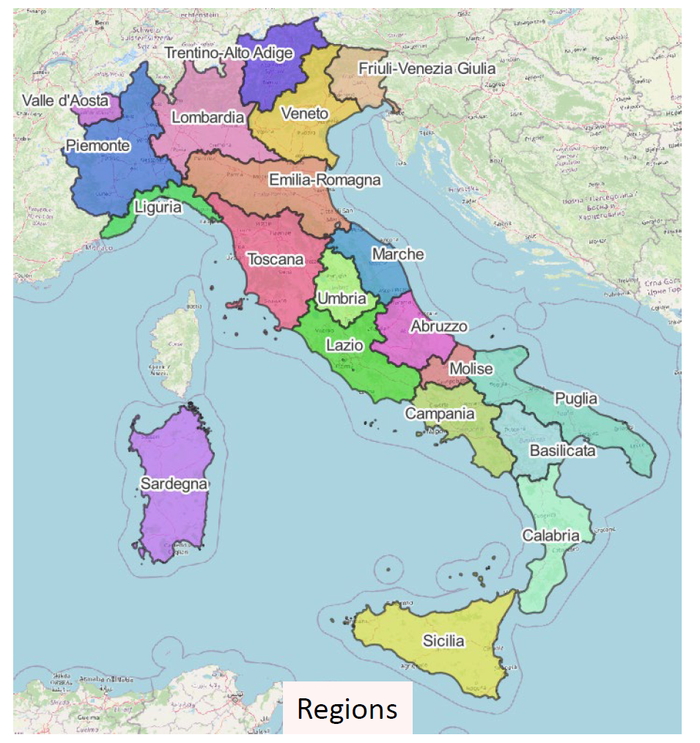
regional level

Slide 4
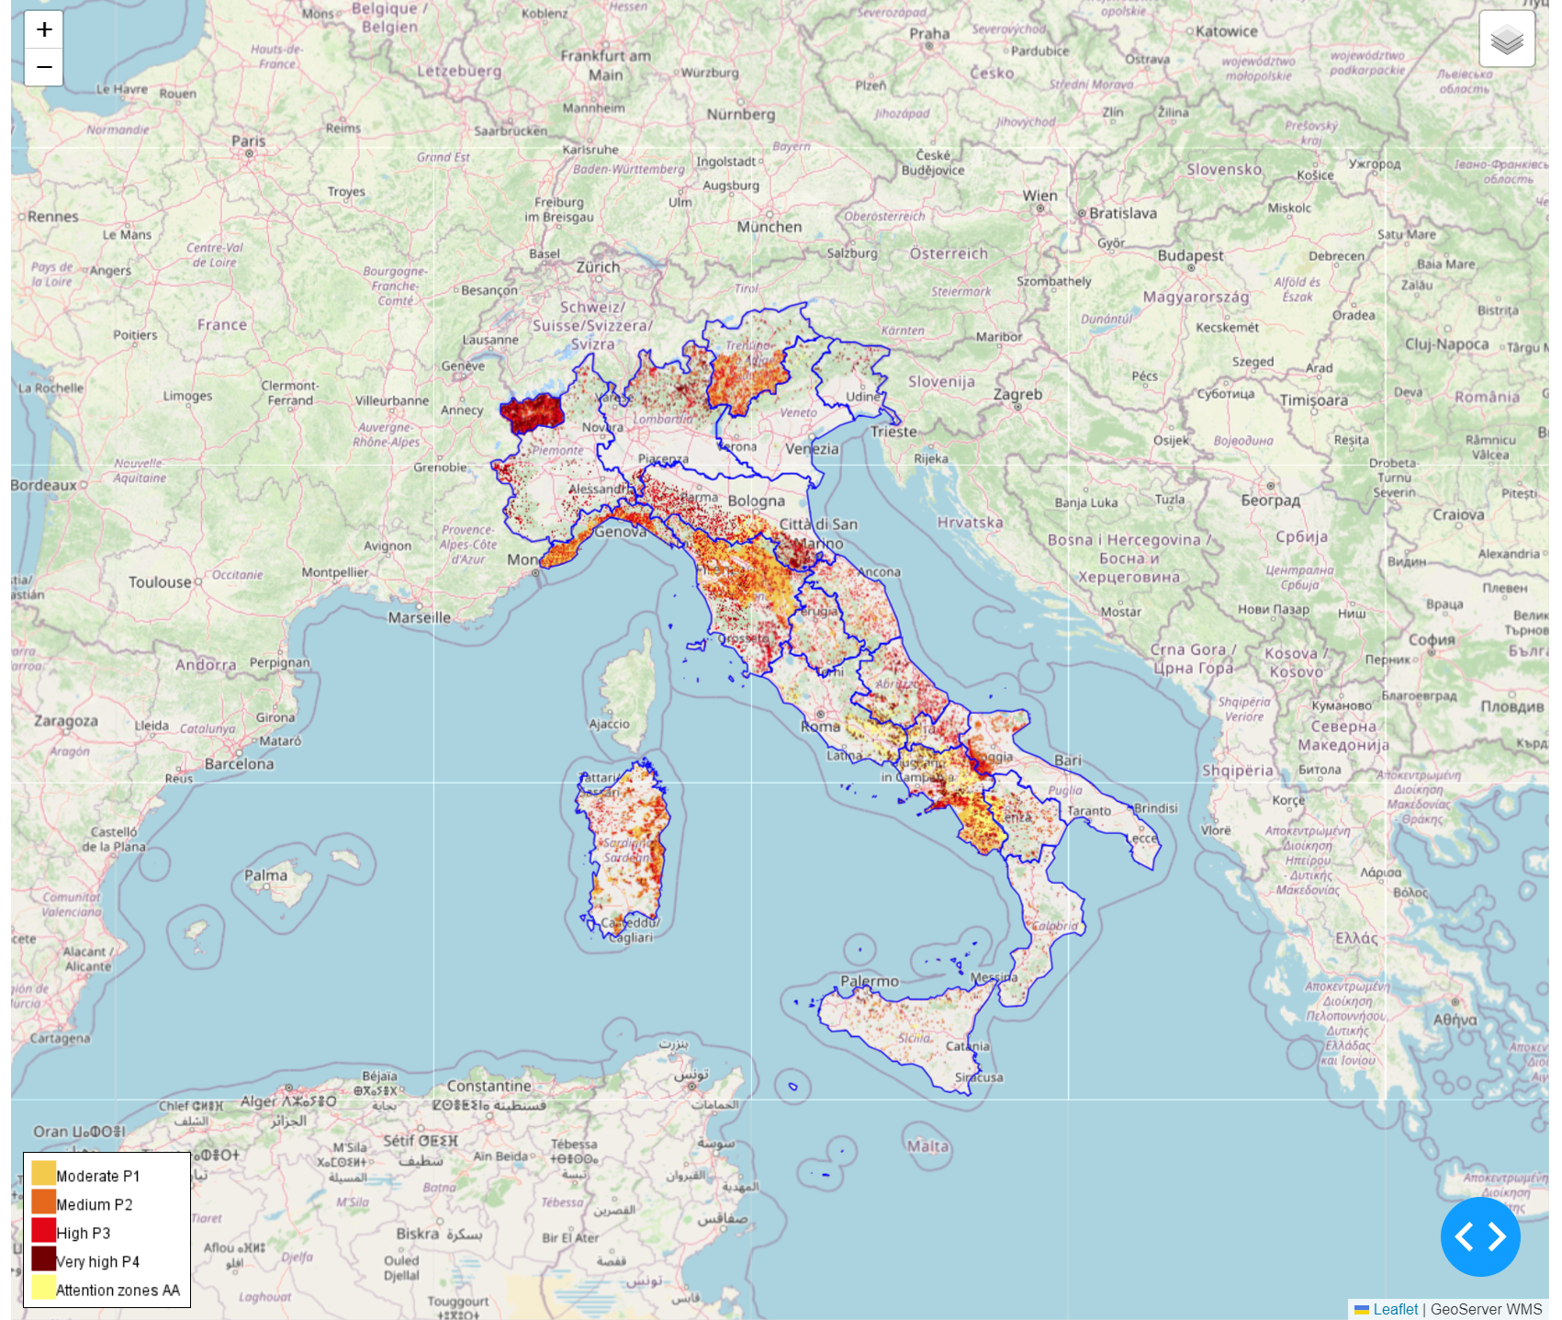
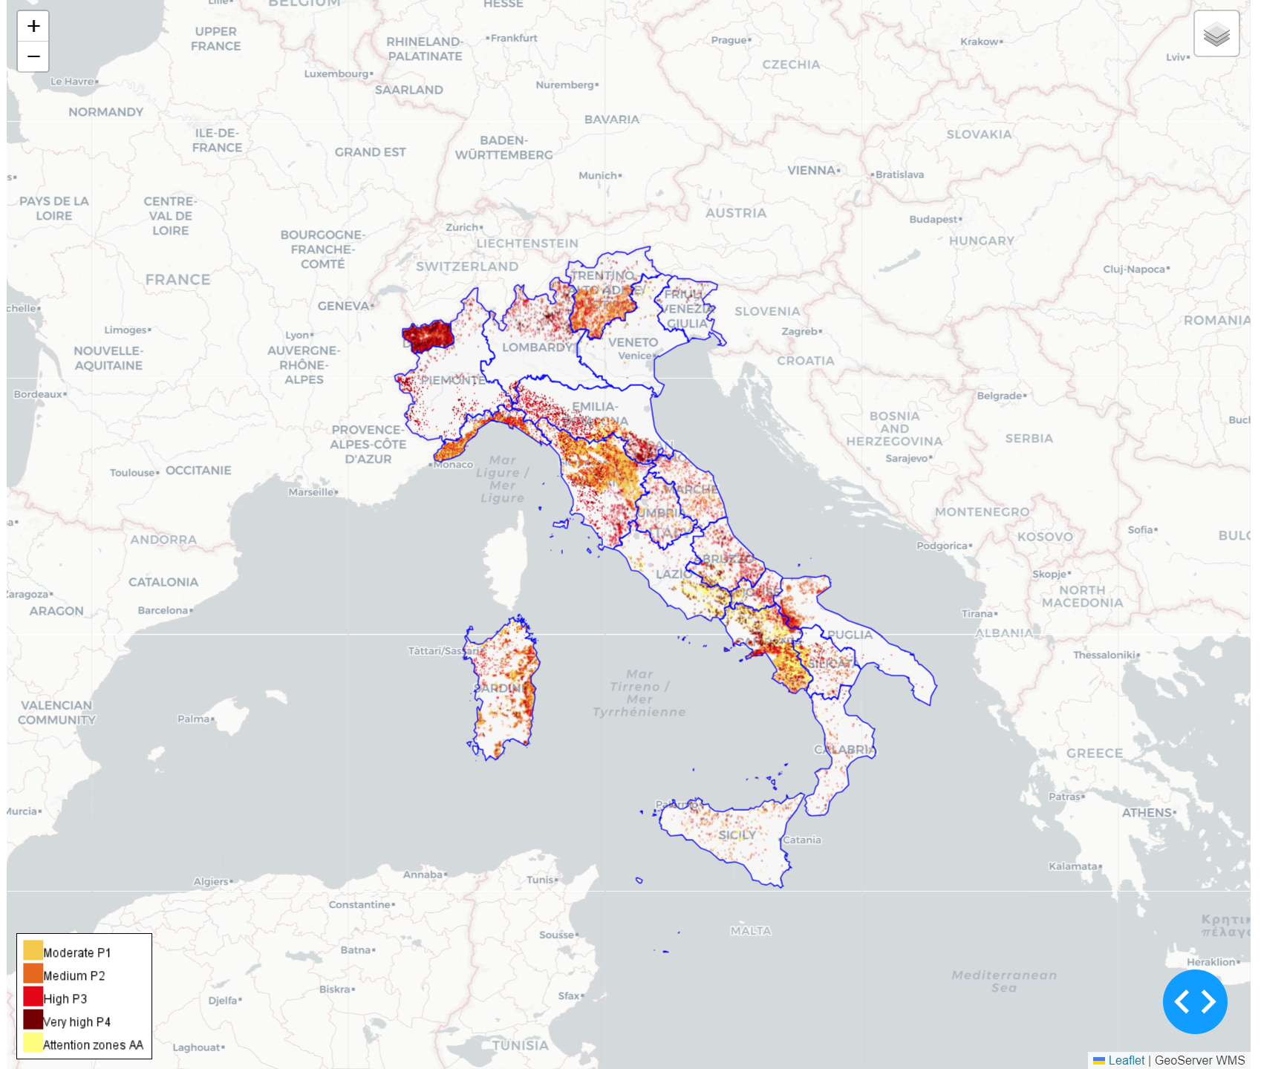
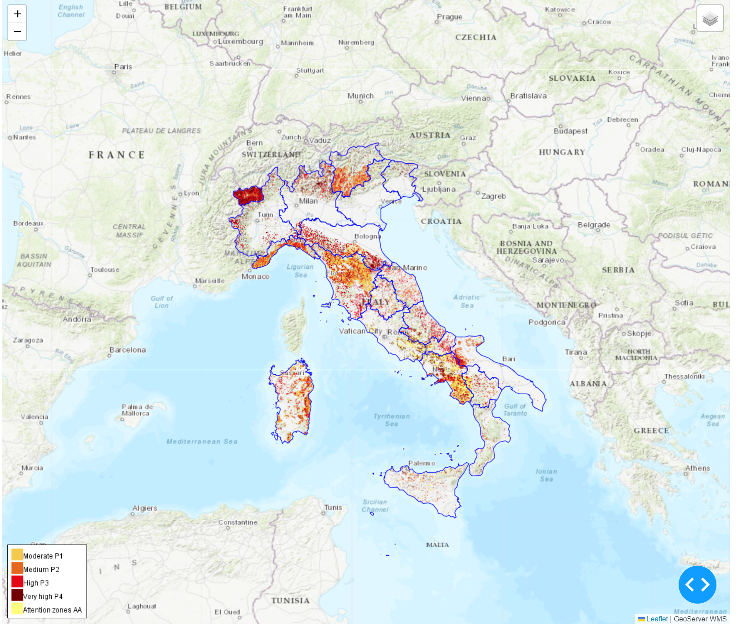
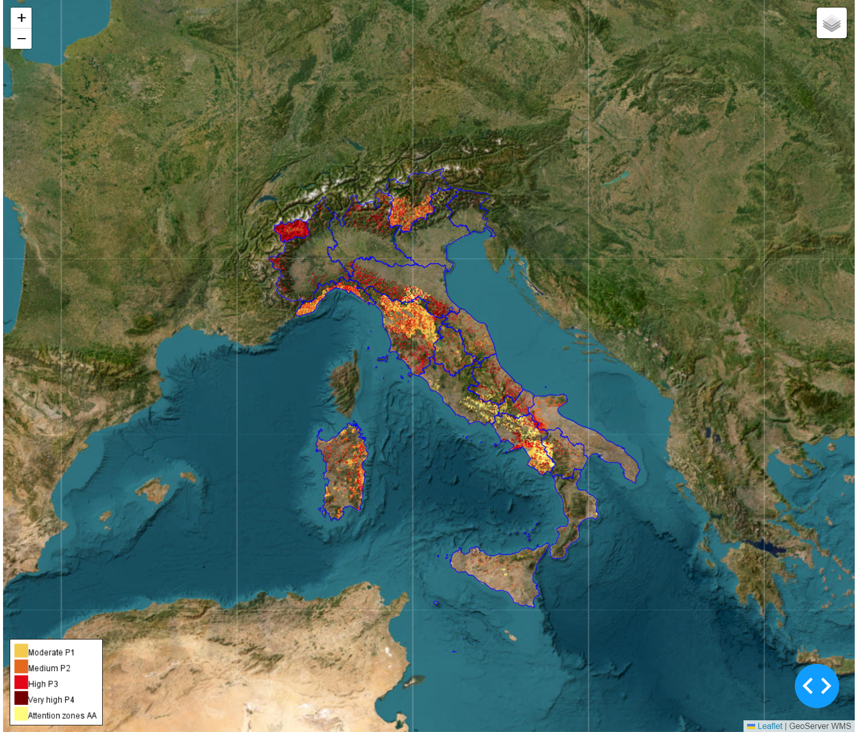
Open street map
Carto Positron
Esri Topographic
Esri World Imagery

Slide 5


Landslide Hazard Map

Slide 6
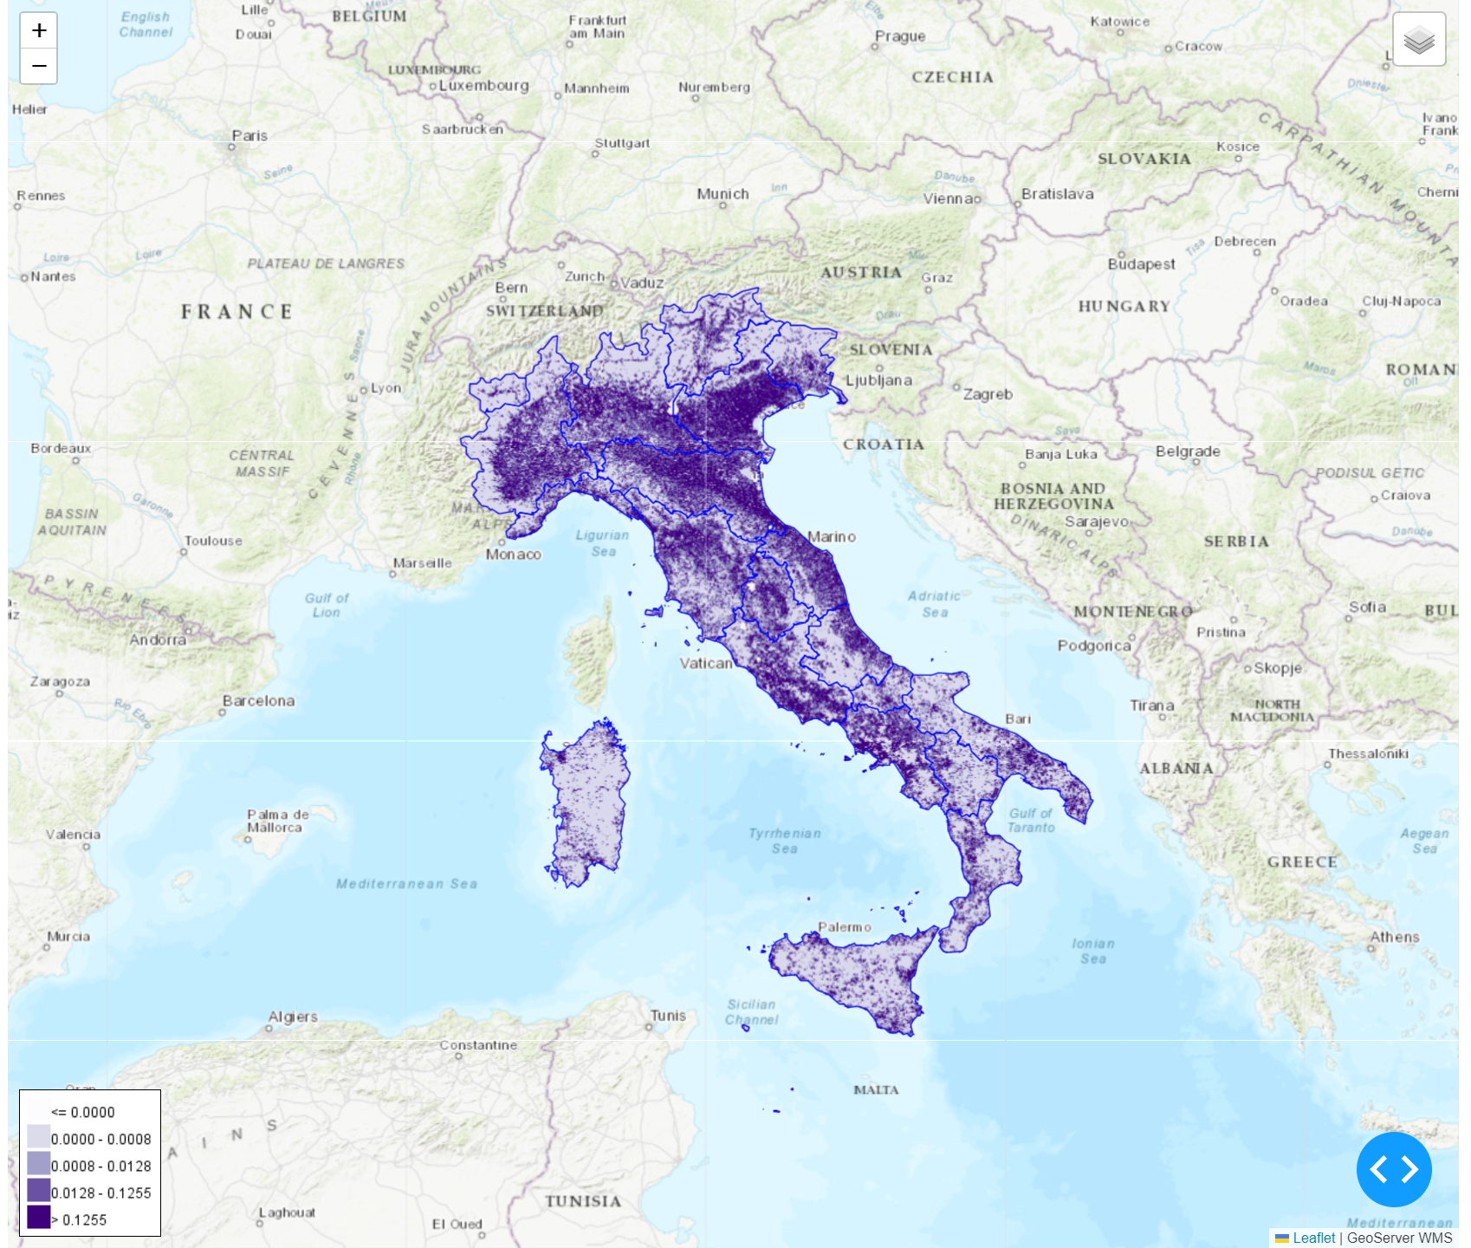
Population Density

Slide 7
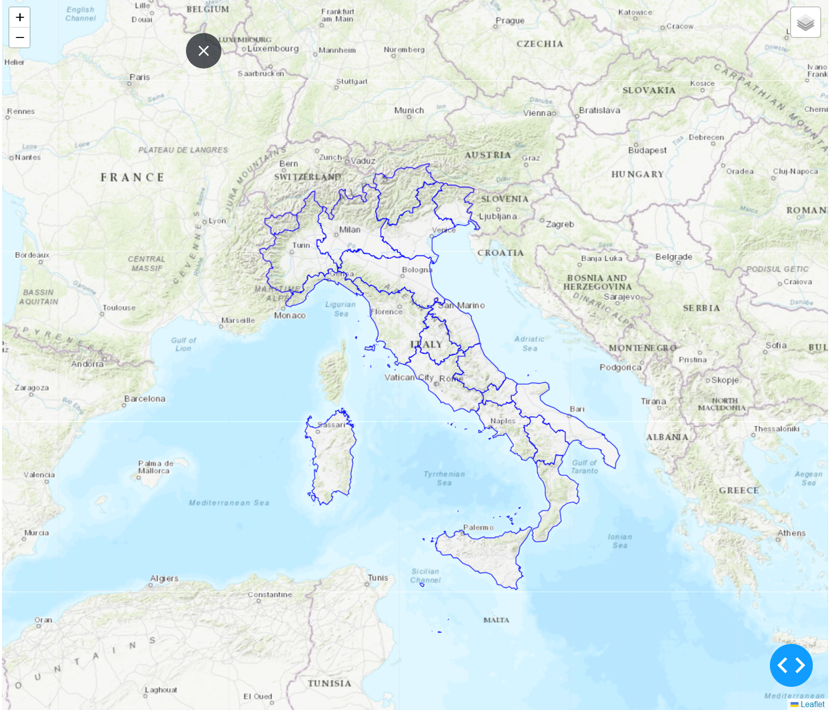
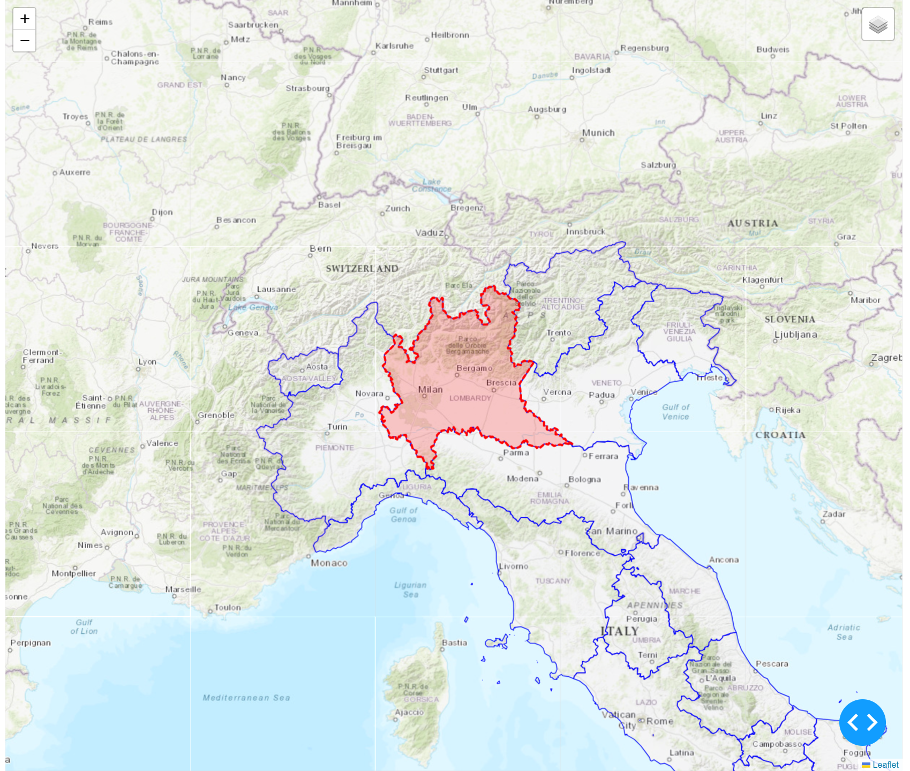
Regions
Selected Region

Slide 8
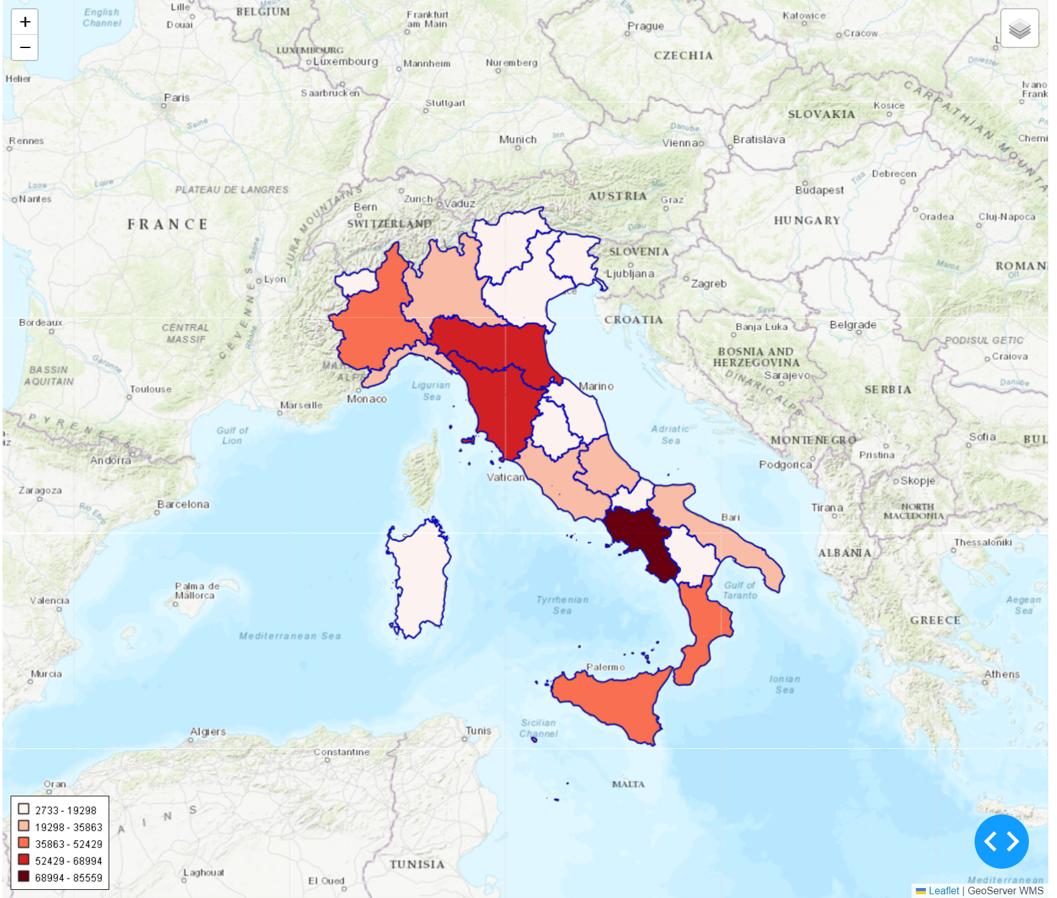
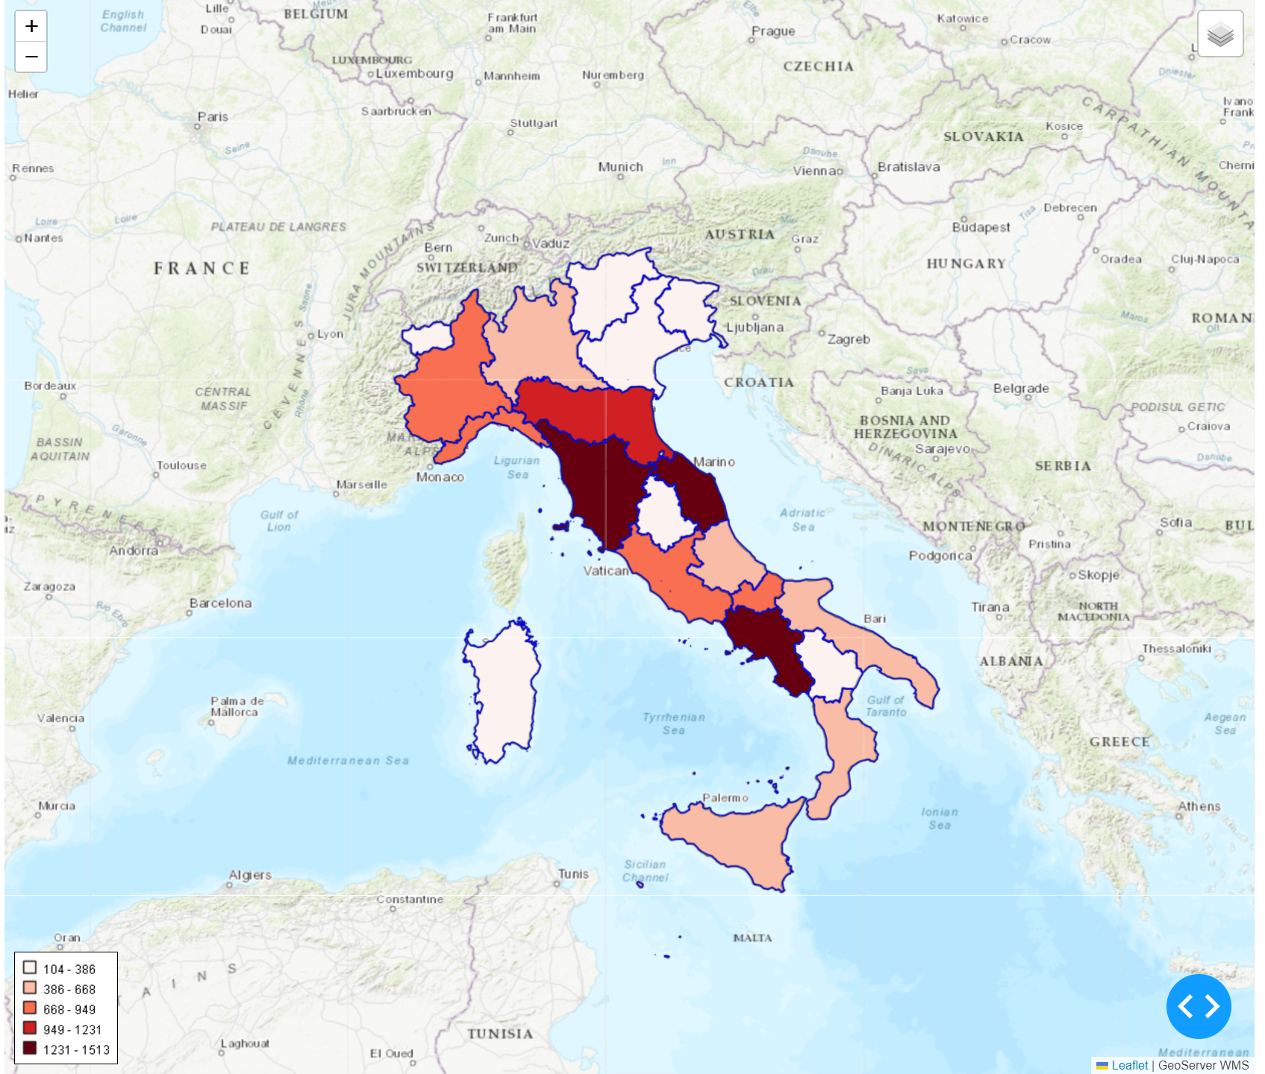
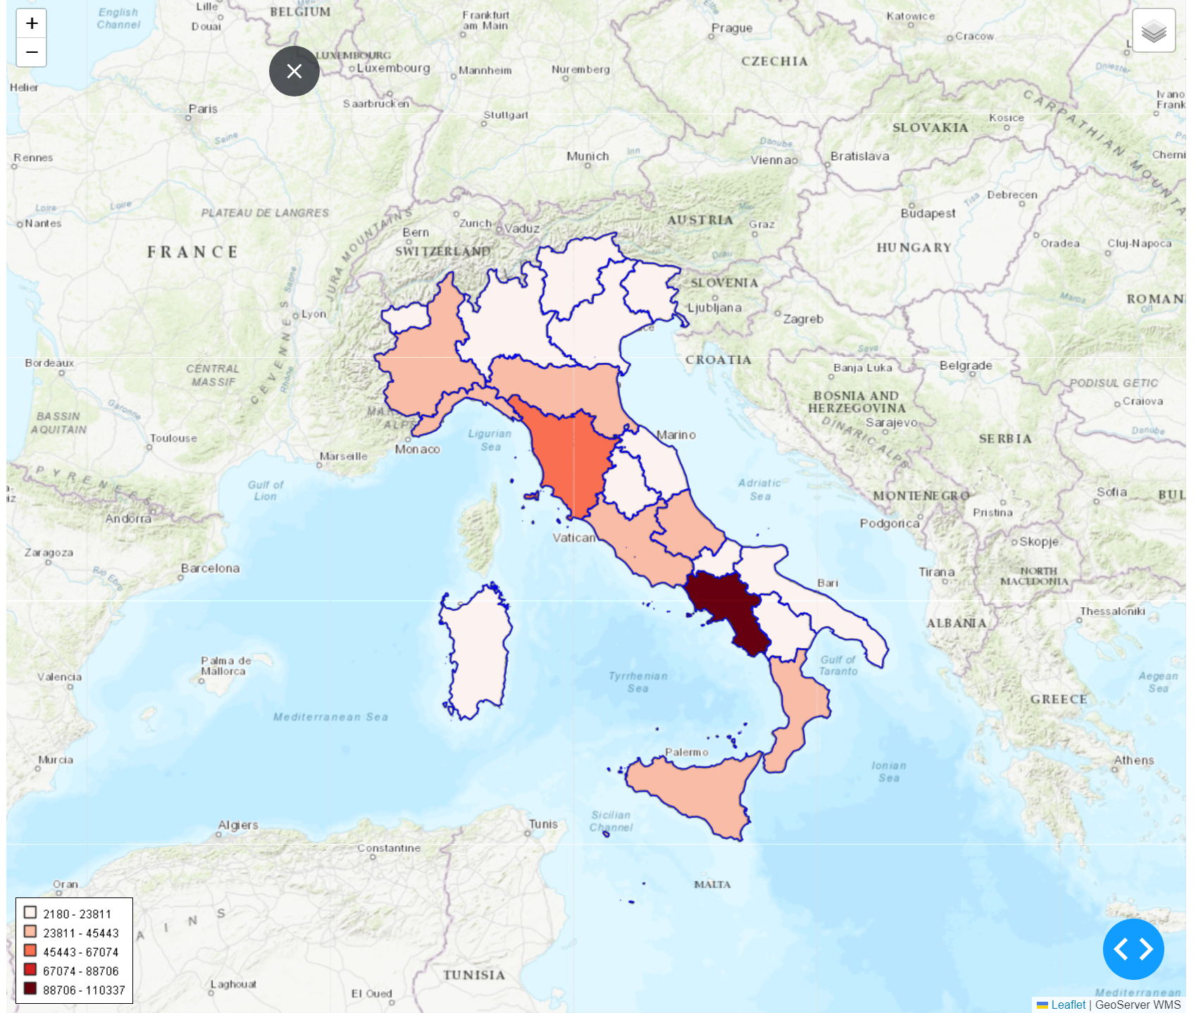
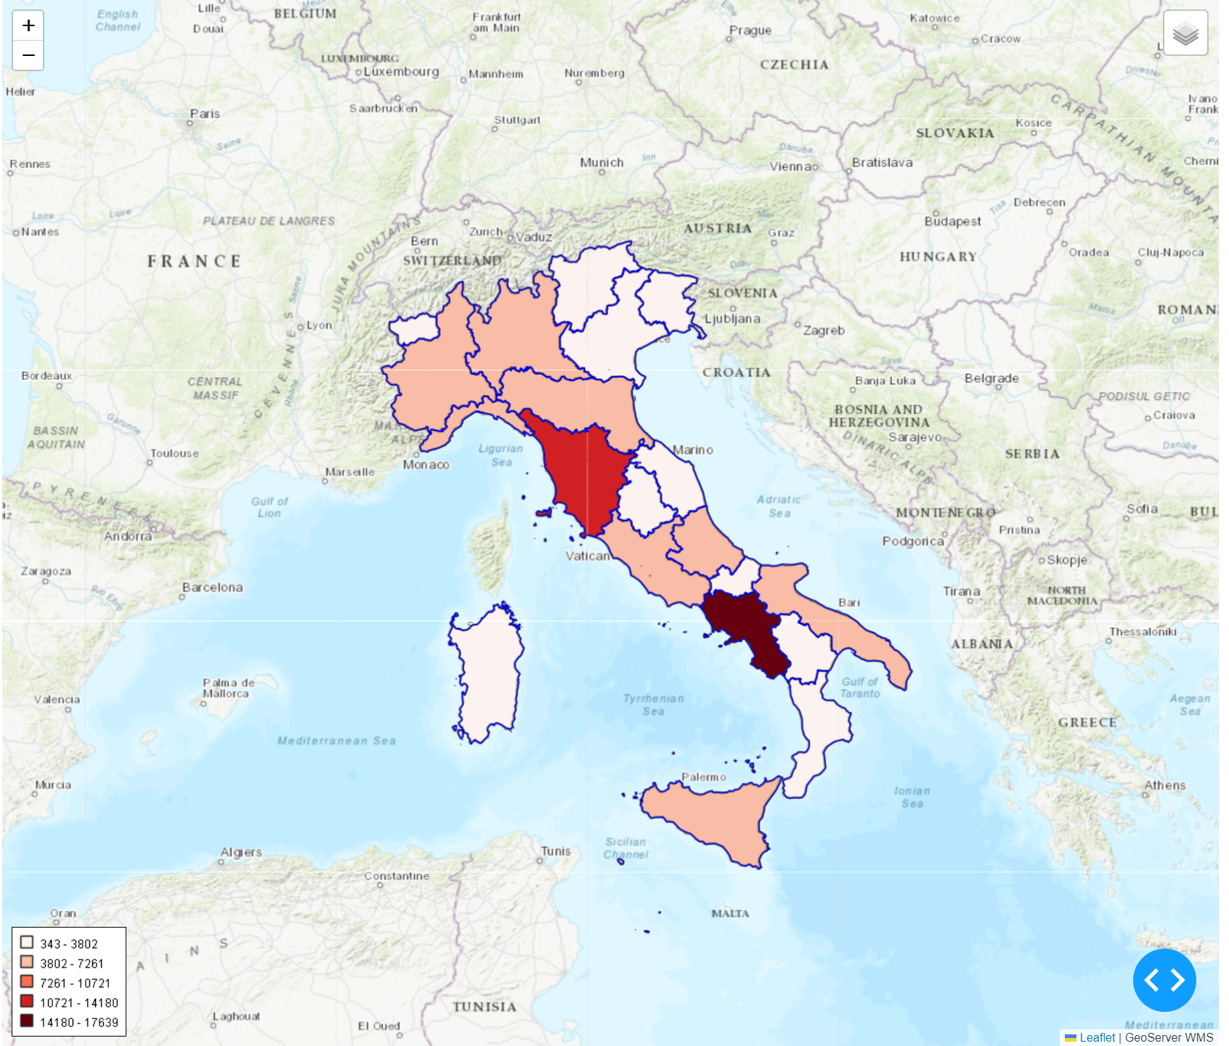
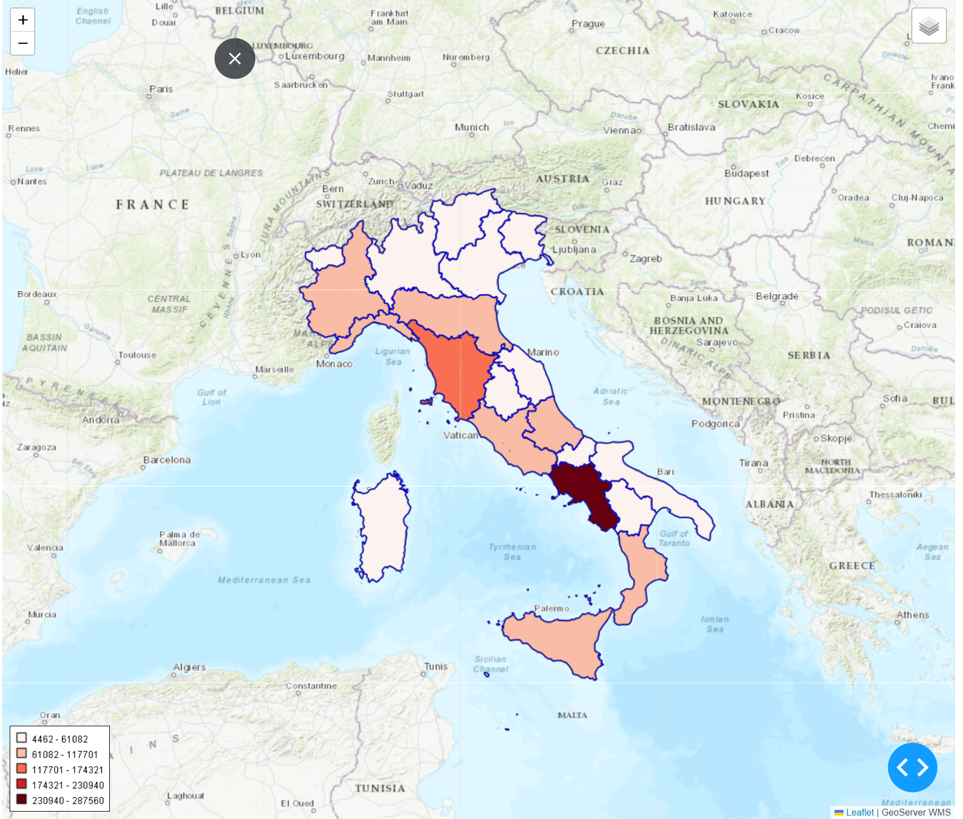
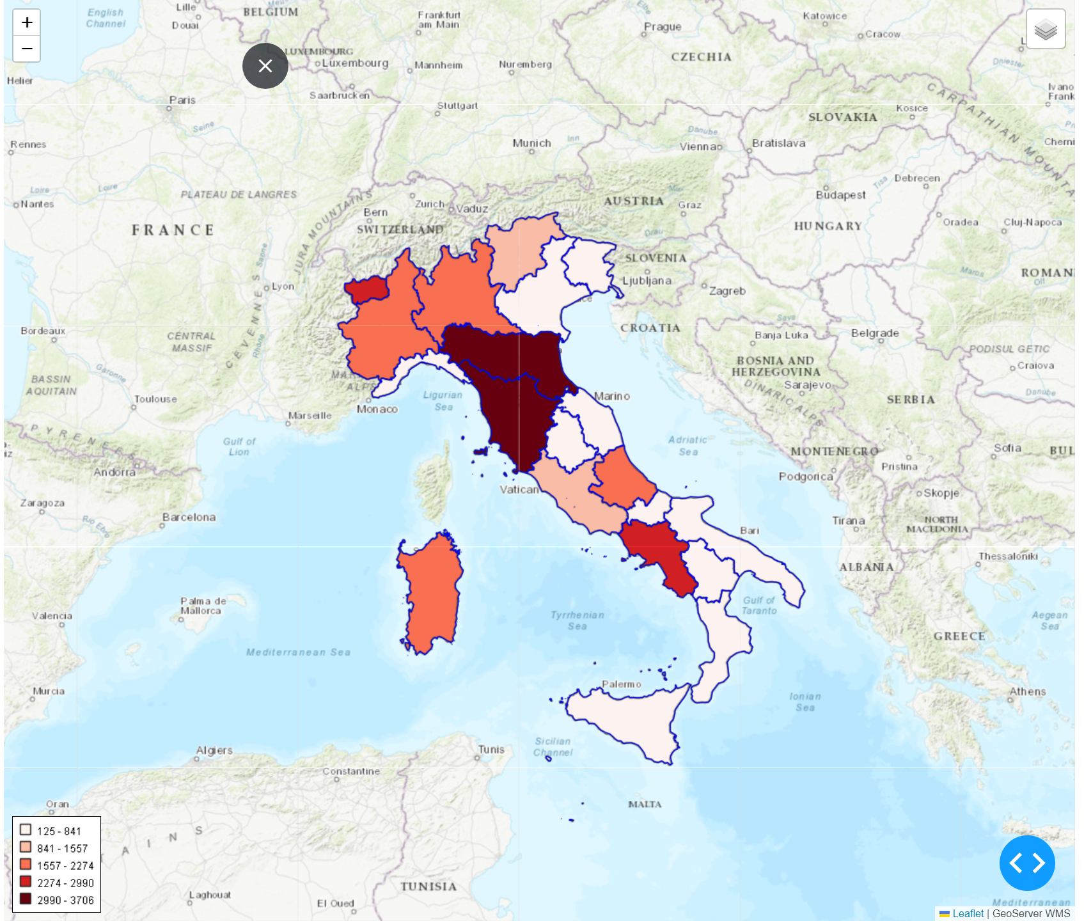
Risk Indicator Buildings
Risk Indicator Cultural Heritage
Risk Indicator Families
Risk Indicator Industries and Services
Risk Indicator Industries and Services
Risk Indicator Industries and Services

Slide 9
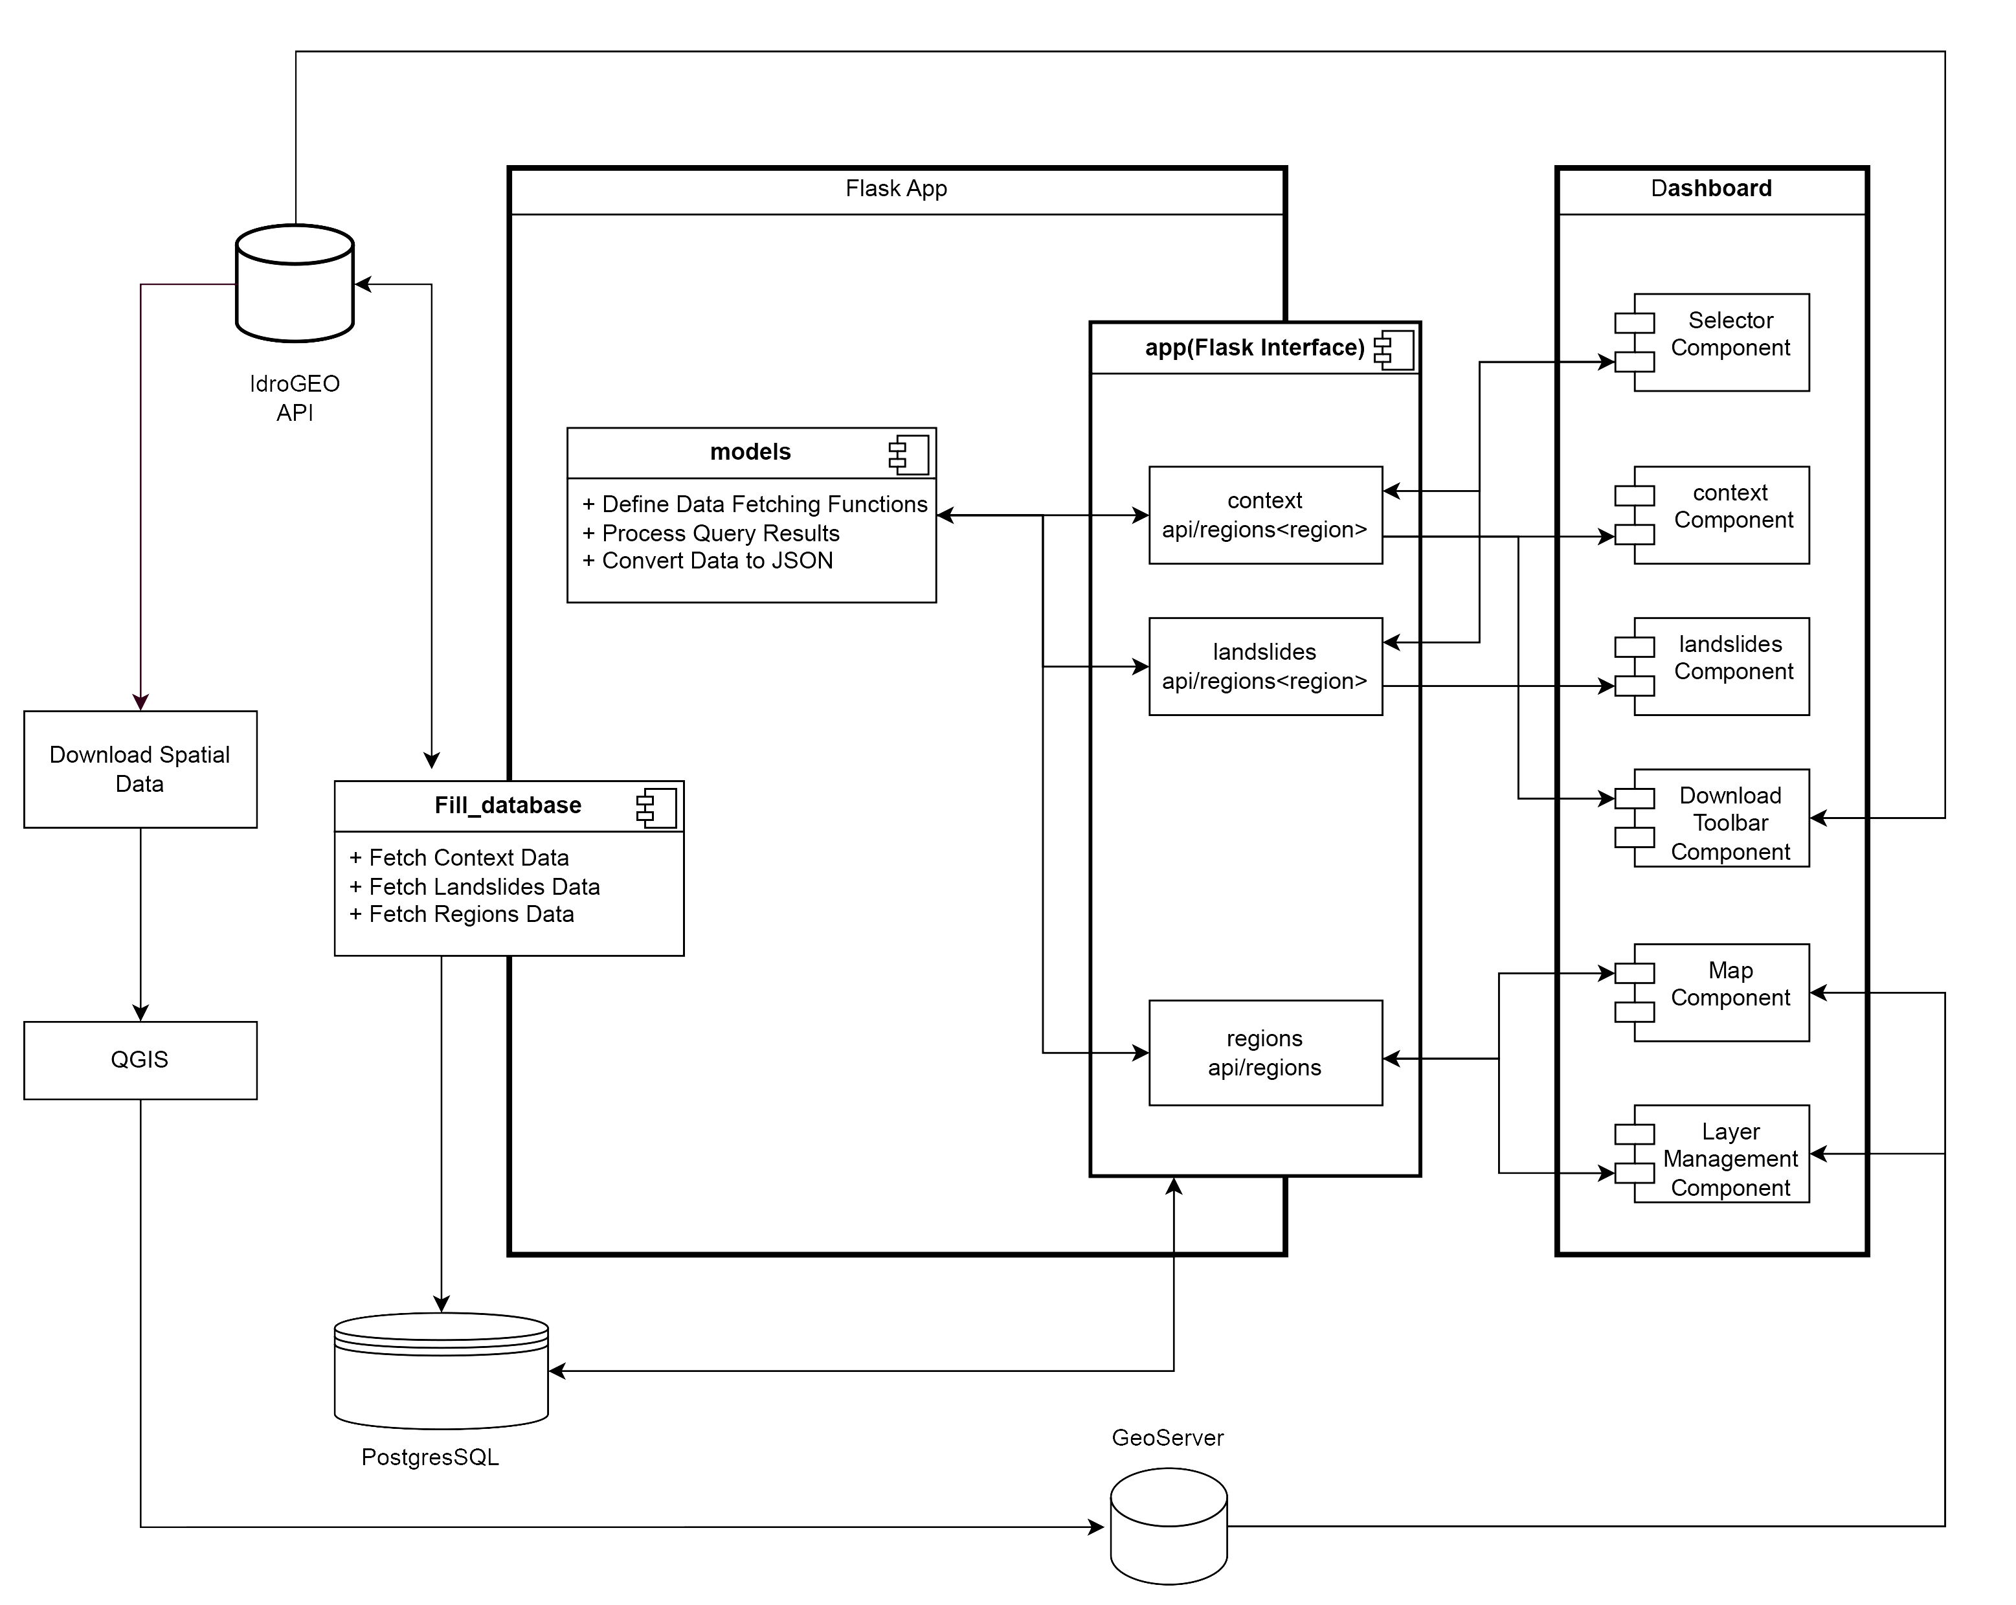
Component Diagrams

Slide 10
 | regions
Primary Key | id
 | cod_rip
 | cod_reg
 | den_reg
 | shape_leng
 | shape_area
 | geom
Foreign Key
Foreign Key
 | context_data_{id}
 | territory_km2
 | industries...
 | buildings
 | cultural...
 | population
 | families
 | children...
 | adults...
 | elderly...
 | landslides_data_{id}
 | category
 | territory
 | population
 | families
 | buildings
 | industries_and...
 | cultural_heritage
Database ER diagram

Slide 11
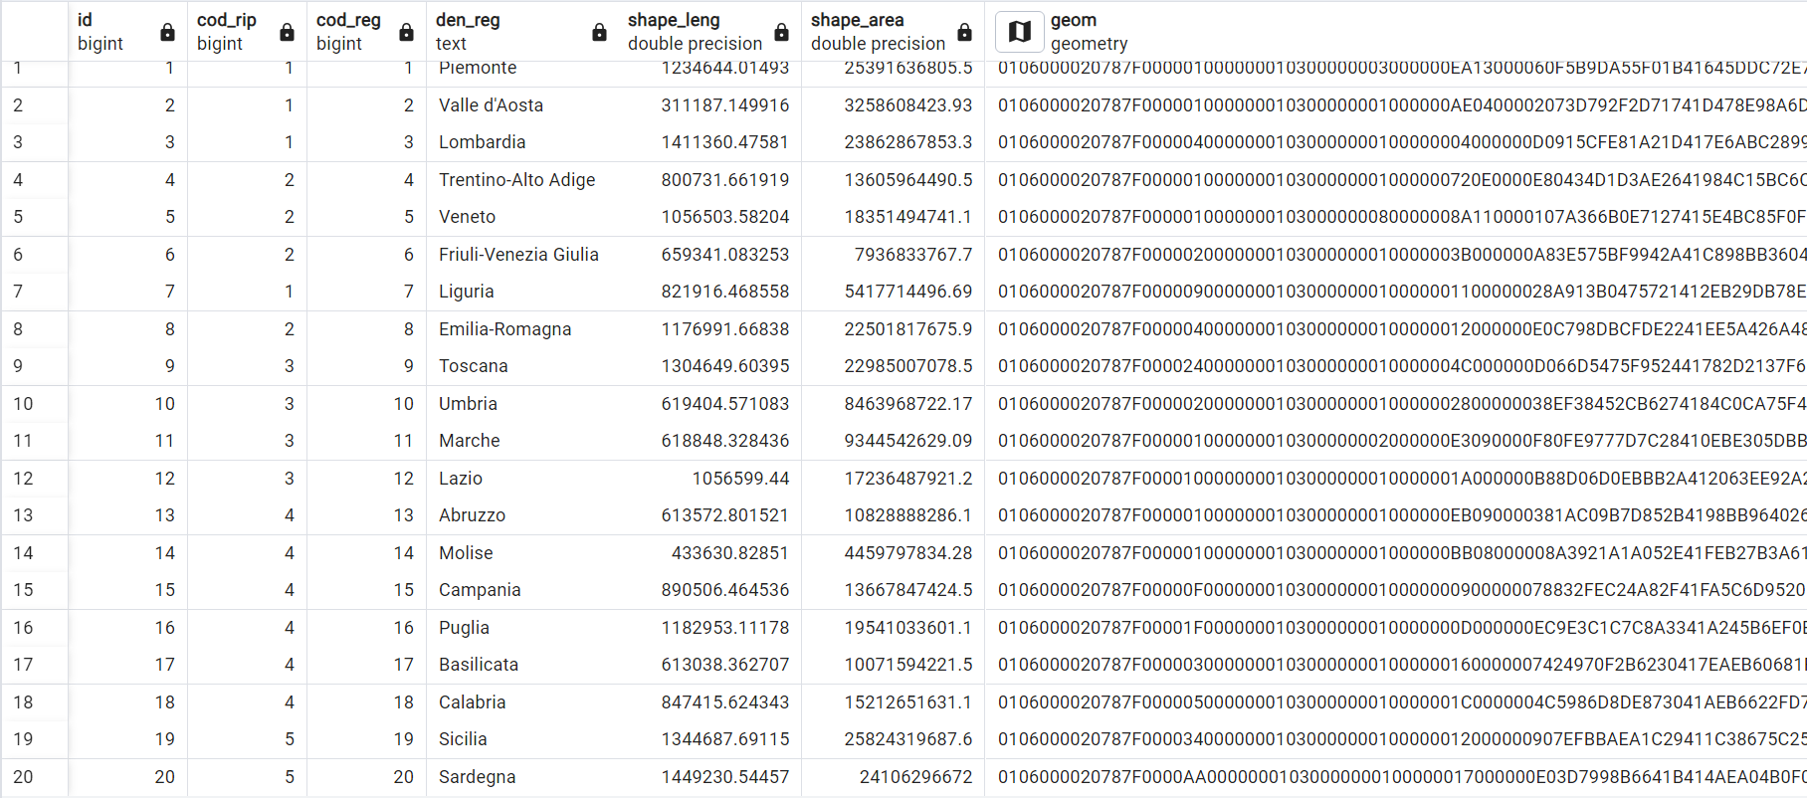
Regions(geopandas dataframe)

Slide 12
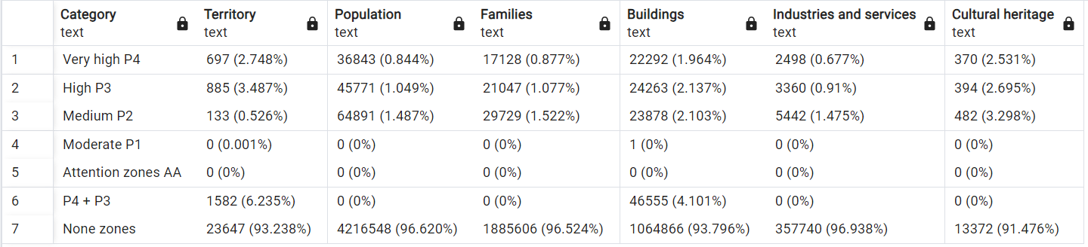
context_data_{id}
landslides_data_{id}

Slide 13
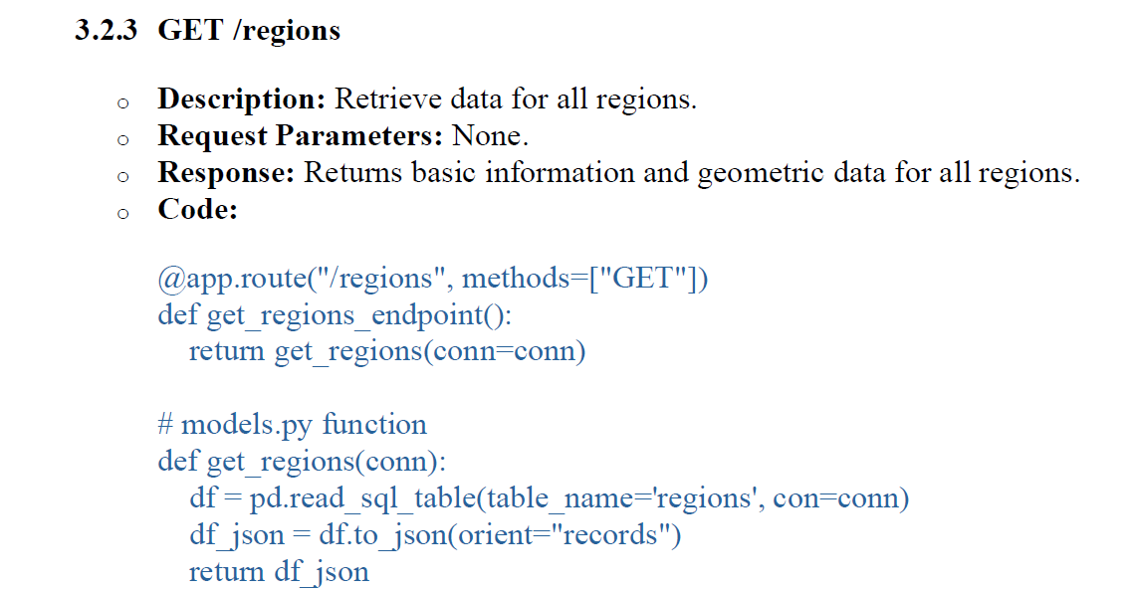
REST APIs

Slide 14
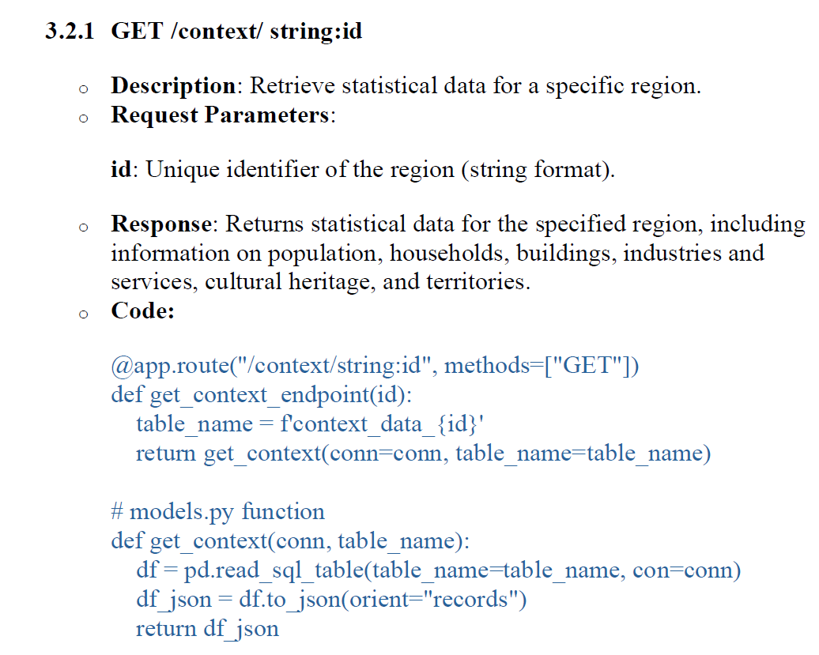
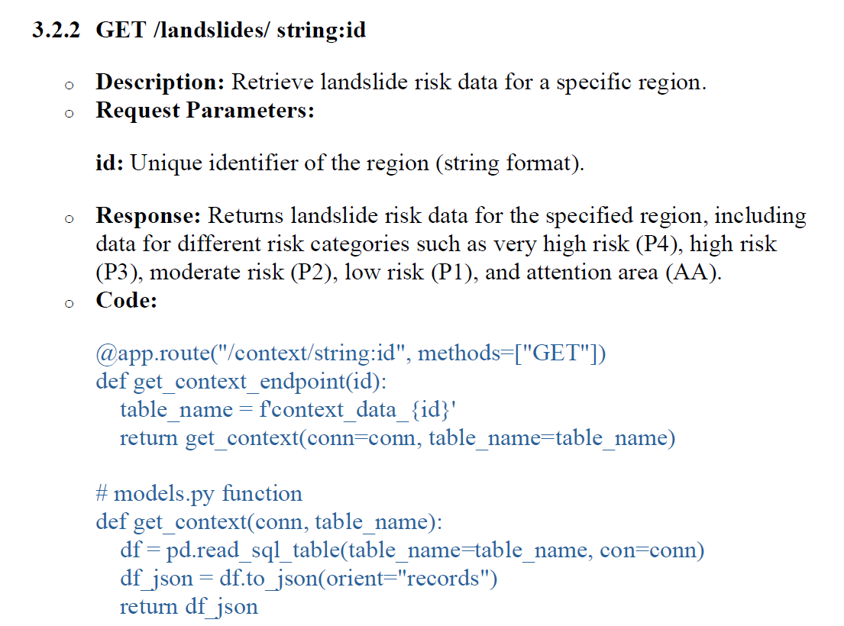
REST APIs

